Slide 1

Capstone assignment
Café in Flushing

Slide 2
Introduction / Business Problems
In Seoul, Korea there are lots of coffee places. Actually there is a coffee shop like Starbucks every corner in Seoul. In Flushing, US there are Korea town and someone who plans to emigrate in US want to check whether cafe business in Flushing is reasonable or not as he operated café for few years in Korea. He strongly believe Korean like coffee and café to meet and talk with friends. So when starting café business in Korea town in Flashing area, he think he can make money.

Slide 3
Data
From Foursquare location data, we will see what kind of business categories are in both Seoul and Flushing area. Also how many coffee places.
Some visualization tool like map, bar chart will be used to show area and comparison result.
Foursquare location data for Seoul Korea and Flushing US
Methodology
Make data frame for places & category info from Foursquare location data, and count by category. Visualize area info by folium.Map and compare by bar chart.

Slide 4
Result
100 venues in Seoul were returned by Foursquare.
60 venues in Flushing were returned by Foursquare.
1 coffee shop, 1 café, and 1 tea room from 60 venues of Flushing
10 coffee shop, 4 café, and 1 tea room from 100 venues of Seoul
Limitation: When checking Foursquare data for Korea, it doesn’t cover all area as Foursquare is not famous in Korea. To compare location and place data from the same site, I will use this data but it doesn’t seem actual data.

Slide 5
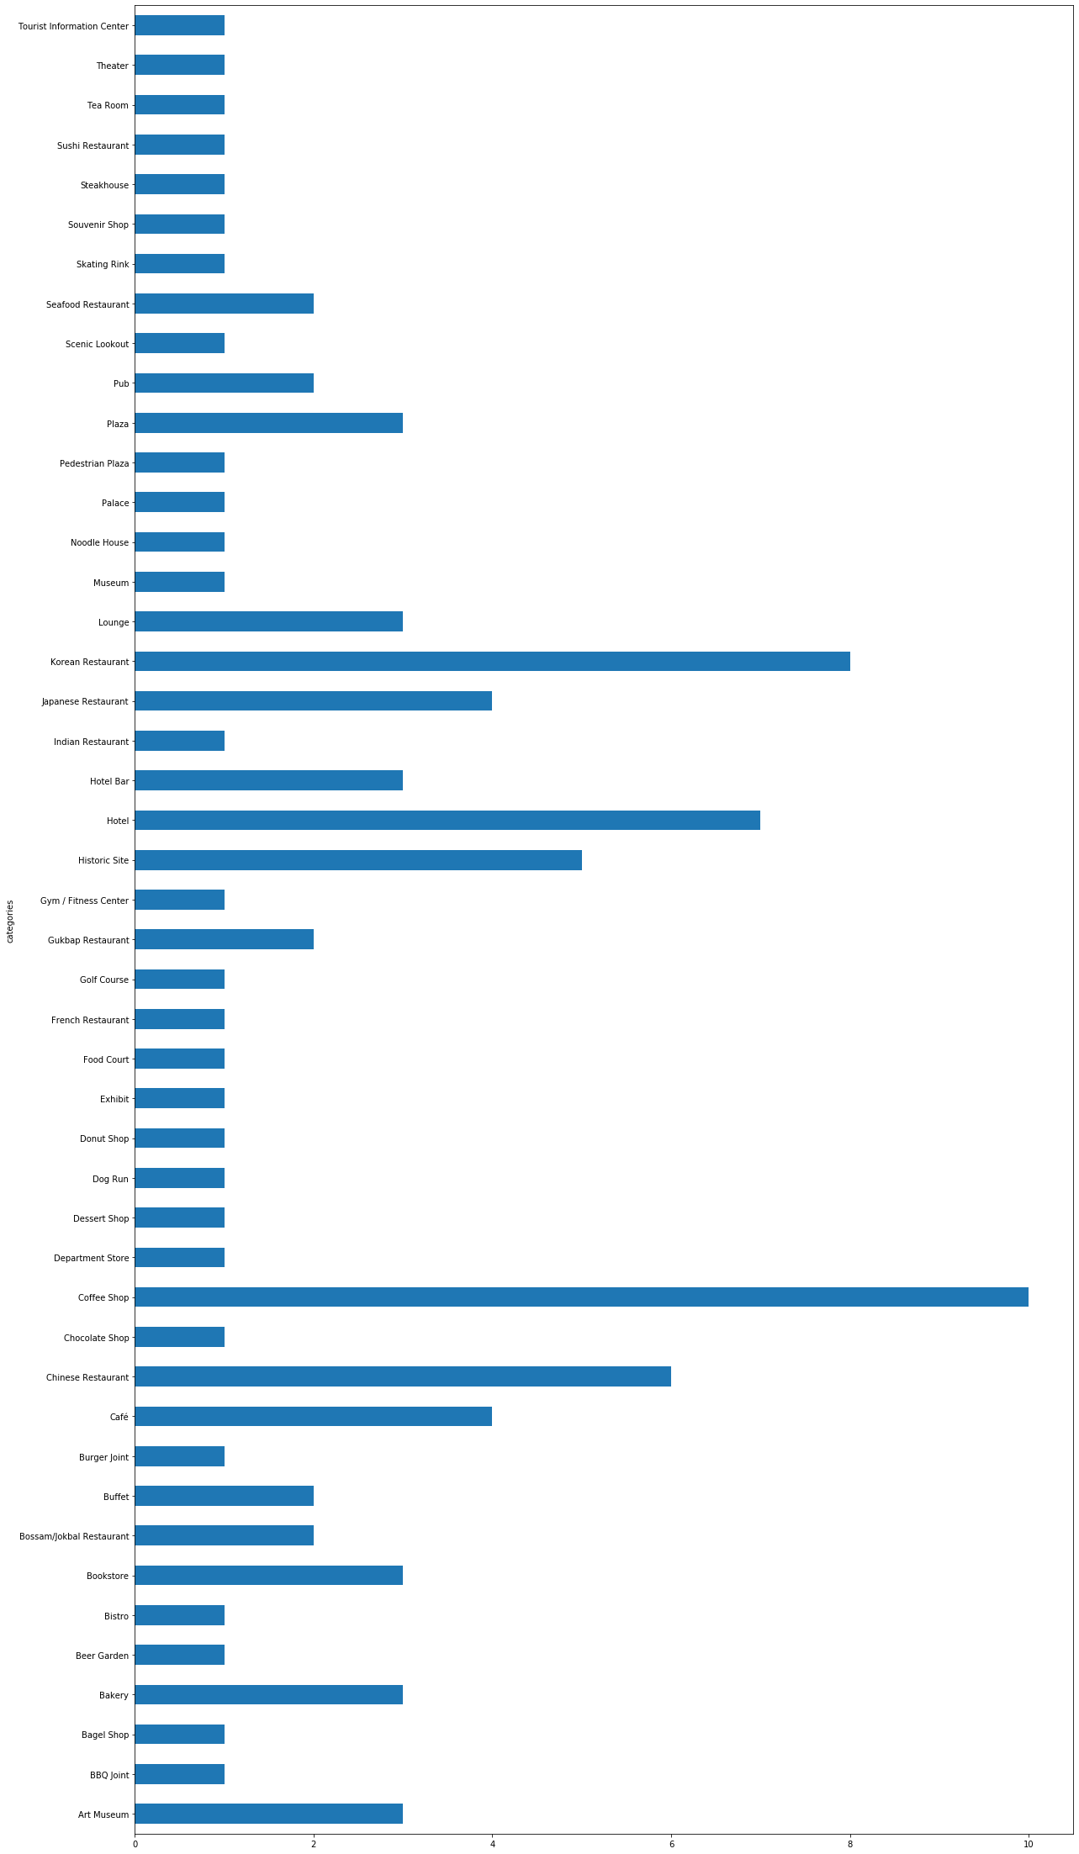
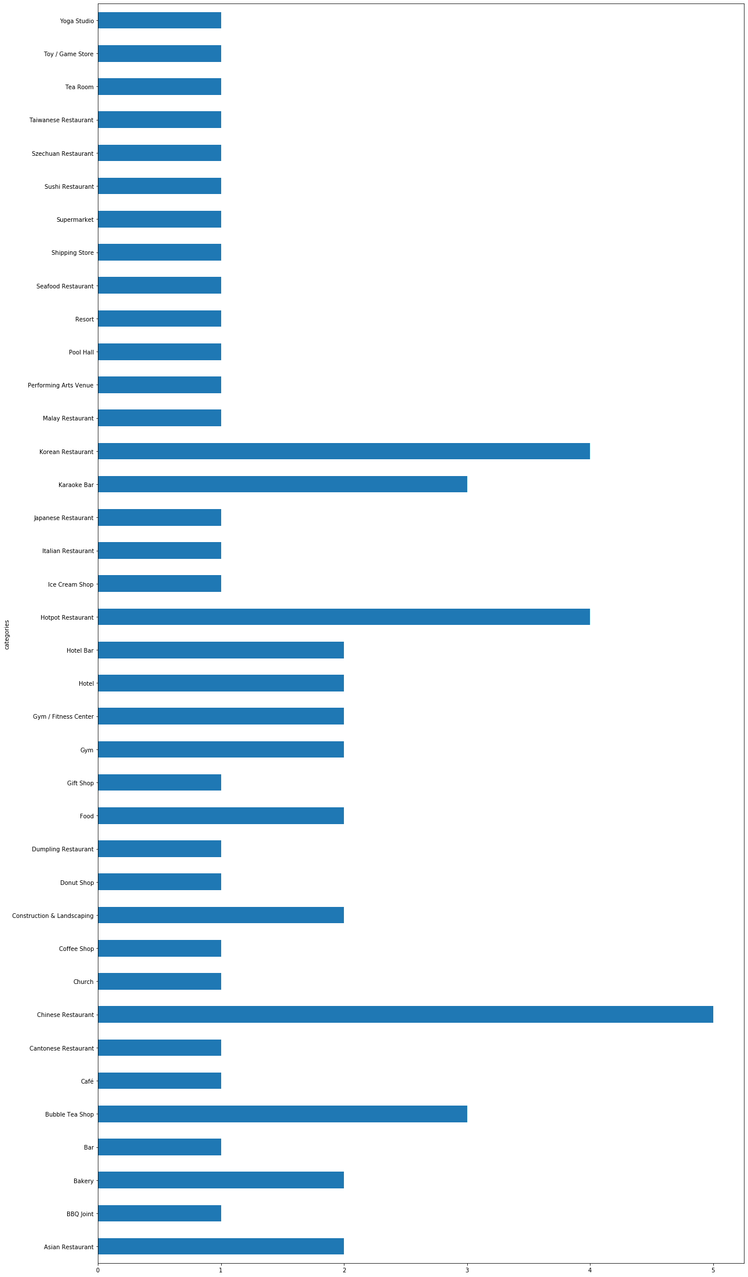
Result
name | lat | lng
categories
Asian Restaurant | 2 | 2 | 2
BBQ Joint | 1 | 1 | 1
Bakery | 2 | 2 | 2
Bar | 1 | 1 | 1
Bubble Tea Shop | 3 | 3 | 3
Café | 1 | 1 | 1
Cantonese Restaurant | 1 | 1 | 1
Chinese Restaurant | 5 | 5 | 5
Church | 1 | 1 | 1
Coffee Shop | 1 | 1 | 1
Construction & Landscaping | 2 | 2 | 2
Donut Shop | 1 | 1 | 1
Dumpling Restaurant | 1 | 1 | 1
Food | 2 | 2 | 2
Gift Shop | 1 | 1 | 1
Gym | 2 | 2 | 2
Gym / Fitness Center | 2 | 2 | 2
Hotel | 2 | 2 | 2
Hotel Bar | 2 | 2 | 2
Hotpot Restaurant | 4 | 4 | 4
Ice Cream Shop | 1 | 1 | 1
Italian Restaurant | 1 | 1 | 1
Japanese Restaurant | 1 | 1 | 1
Karaoke Bar | 3 | 3 | 3
Korean Restaurant | 4 | 4 | 4
Malay Restaurant | 1 | 1 | 1
Performing Arts Venue | 1 | 1 | 1
Pool Hall | 1 | 1 | 1
Resort | 1 | 1 | 1
Seafood Restaurant | 1 | 1 | 1
Shipping Store | 1 | 1 | 1
Supermarket | 1 | 1 | 1
Sushi Restaurant | 1 | 1 | 1
Szechuan Restaurant | 1 | 1 | 1
Taiwanese Restaurant | 1 | 1 | 1
Tea Room | 1 | 1 | 1
Toy / Game Store | 1 | 1 | 1
Yoga Studio | 1 | 1 | 1
name | lat | lng
categories
Art Museum | 3 | 3 | 3
BBQ Joint | 1 | 1 | 1
Bagel Shop | 1 | 1 | 1
Bakery | 3 | 3 | 3
Beer Garden | 1 | 1 | 1
Bistro | 1 | 1 | 1
Bookstore | 3 | 3 | 3
Bossam/Jokbal Restaurant | 2 | 2 | 2
Buffet | 2 | 2 | 2
Burger Joint | 1 | 1 | 1
Café | 4 | 4 | 4
Chinese Restaurant | 6 | 6 | 6
Chocolate Shop | 1 | 1 | 1
Coffee Shop | 10 | 10 | 10
Department Store | 1 | 1 | 1
Dessert Shop | 1 | 1 | 1
Dog Run | 1 | 1 | 1
Donut Shop | 1 | 1 | 1
Exhibit | 1 | 1 | 1
Food Court | 1 | 1 | 1
French Restaurant | 1 | 1 | 1
Golf Course | 1 | 1 | 1
Gukbap Restaurant | 2 | 2 | 2
Gym / Fitness Center | 1 | 1 | 1
Historic Site | 5 | 5 | 5
Hotel | 7 | 7 | 7
Hotel Bar | 3 | 3 | 3
Indian Restaurant | 1 | 1 | 1
Japanese Restaurant | 4 | 4 | 4
Korean Restaurant | 8 | 8 | 8
Lounge | 3 | 3 | 3
Museum | 1 | 1 | 1
Noodle House | 1 | 1 | 1
Palace | 1 | 1 | 1
Pedestrian Plaza | 1 | 1 | 1
Plaza | 3 | 3 | 3
Pub | 2 | 2 | 2
Scenic Lookout | 1 | 1 | 1
Seafood Restaurant | 2 | 2 | 2
Skating Rink | 1 | 1 | 1
Souvenir Shop | 1 | 1 | 1
Steakhouse | 1 | 1 | 1
Sushi Restaurant | 1 | 1 | 1
Tea Room | 1 | 1 | 1
Theater | 1 | 1 | 1
Tourist Information Center | 1 | 1 | 1

Slide 6
Discussion
Big difference between Seoul and Flushing in terms of population. Only 176K people live in Flushing, but in Seoul 9.8M people live. And downloaded data from Foursquare also are very limited.
But we could say lots of coffee spots in Seoul (15 places from 100 findings) comparing to Flushing (3 places from 60 findings).
Conclusion
Starting cafe business in Flushing is reasonable.

